Slide 1


Slide 2
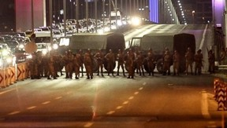
Turkish Coup Attempt 2016
U.S. Intelligence Failures
Global Affairs with Greg Ayres
www.globalaffairswithgregayres.com
28 Feb 2022
[3]

Slide 3
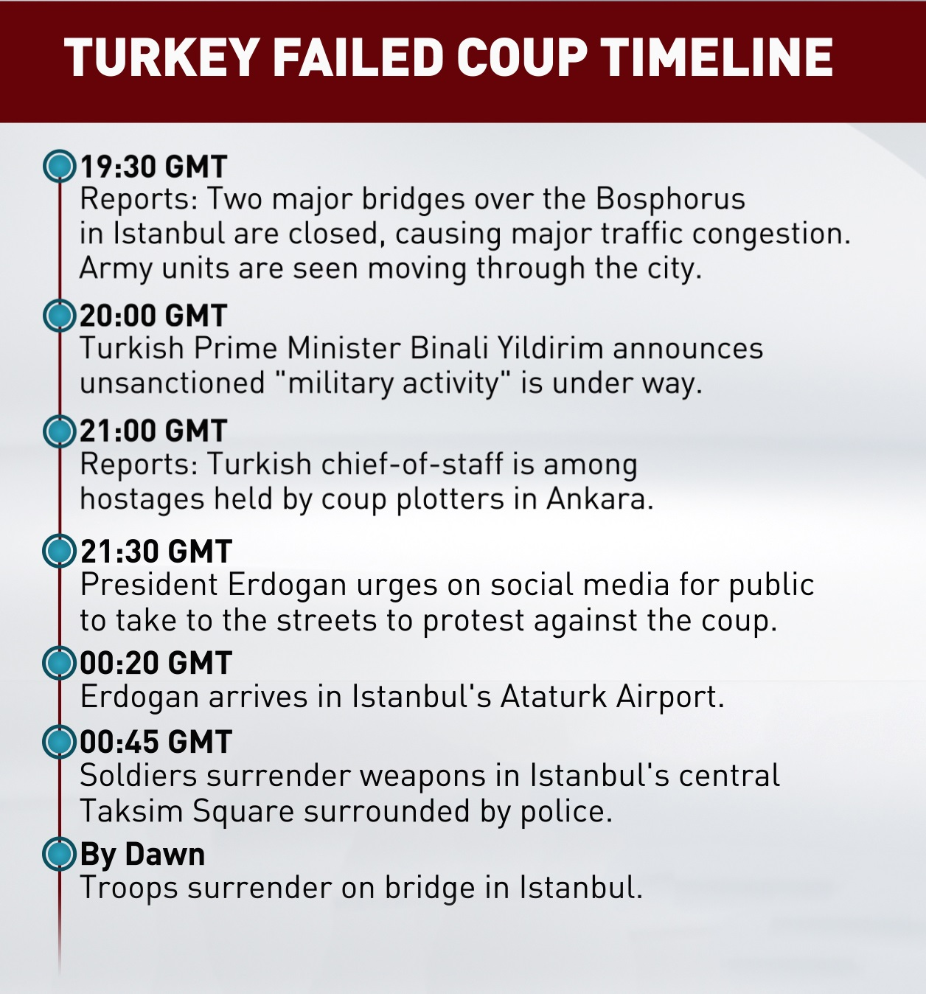
Timeline
[6]

Slide 4

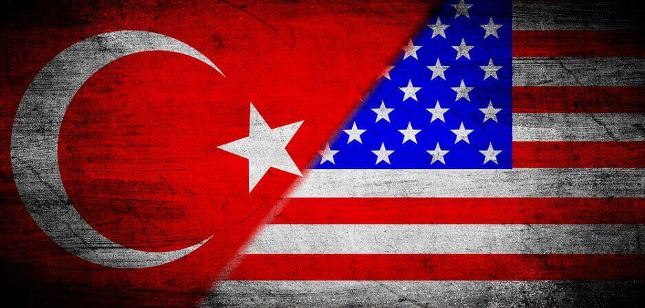
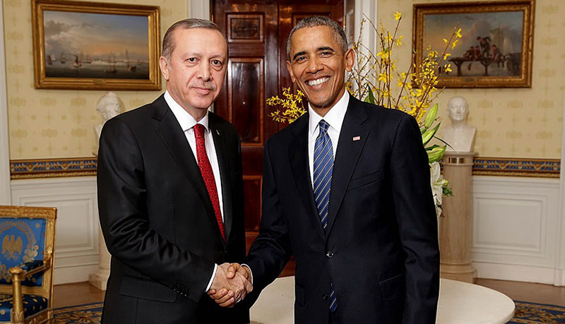
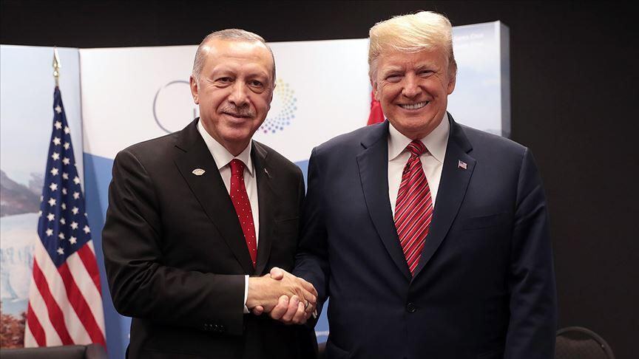
KEY JUDGMENTS
BLUF: Diplomatic relations suffered greatly as the U.S. IC failed to foresee the coup attempt, and underestimated Turkish President Recep Erdoğan’s reaction towards Fethullah Gülen.
Long term deterioration in relations
Loss of regional strategic partner (NATO)

Slide 5
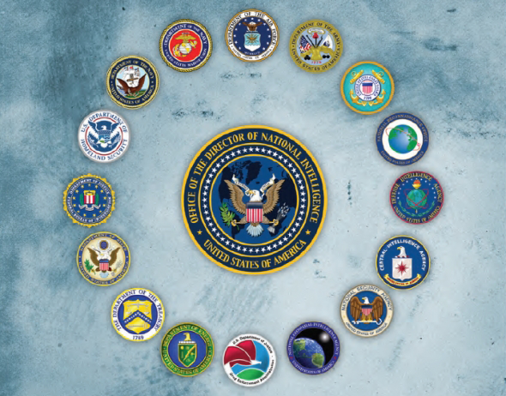
WHO FAILED
Department of State: (HUMINT) Failed to foresee coup attempt, failed to control Erdoğan’s diplomatic reaction
Defense Intelligence Agency: (HUMINT) DIA failure to understand leanings of Turkey’s military leadership
Central Intelligence Agency: (HUMINT) Failed to assess Erdogan’s personal reaction to coup, reaction towards U.S. protection of Gülen

Slide 6
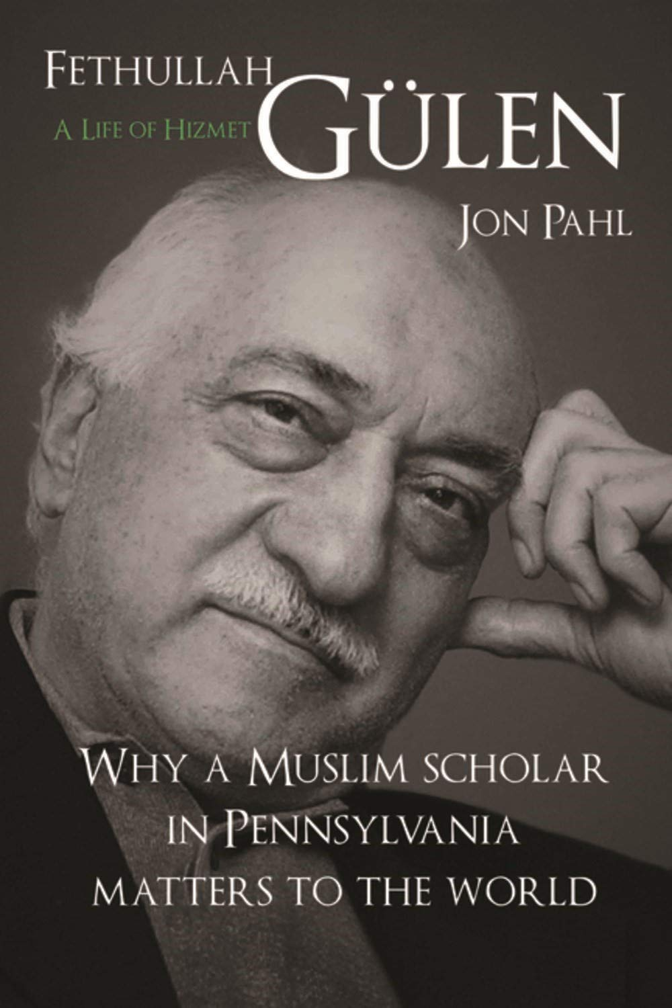
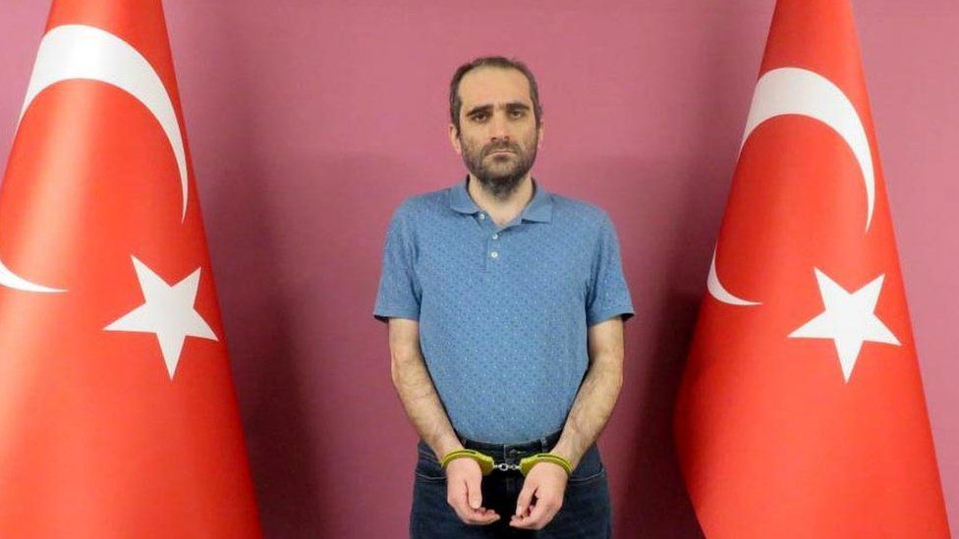
IC Biases Lead to IC Failures
Historical Bias:
  Turkey as a longstanding NATO ally
  Gulen as the coup plotter
Fundamental Attribution Bias:
  Protecting Gulen
  Standing up for the Kurds
Confirmation Bias
  Protecting Gulen
  Standing up for the Kurds
[2]
Gülen’s nephew is extradited from Kenya over coup plot. (2021)

Slide 7
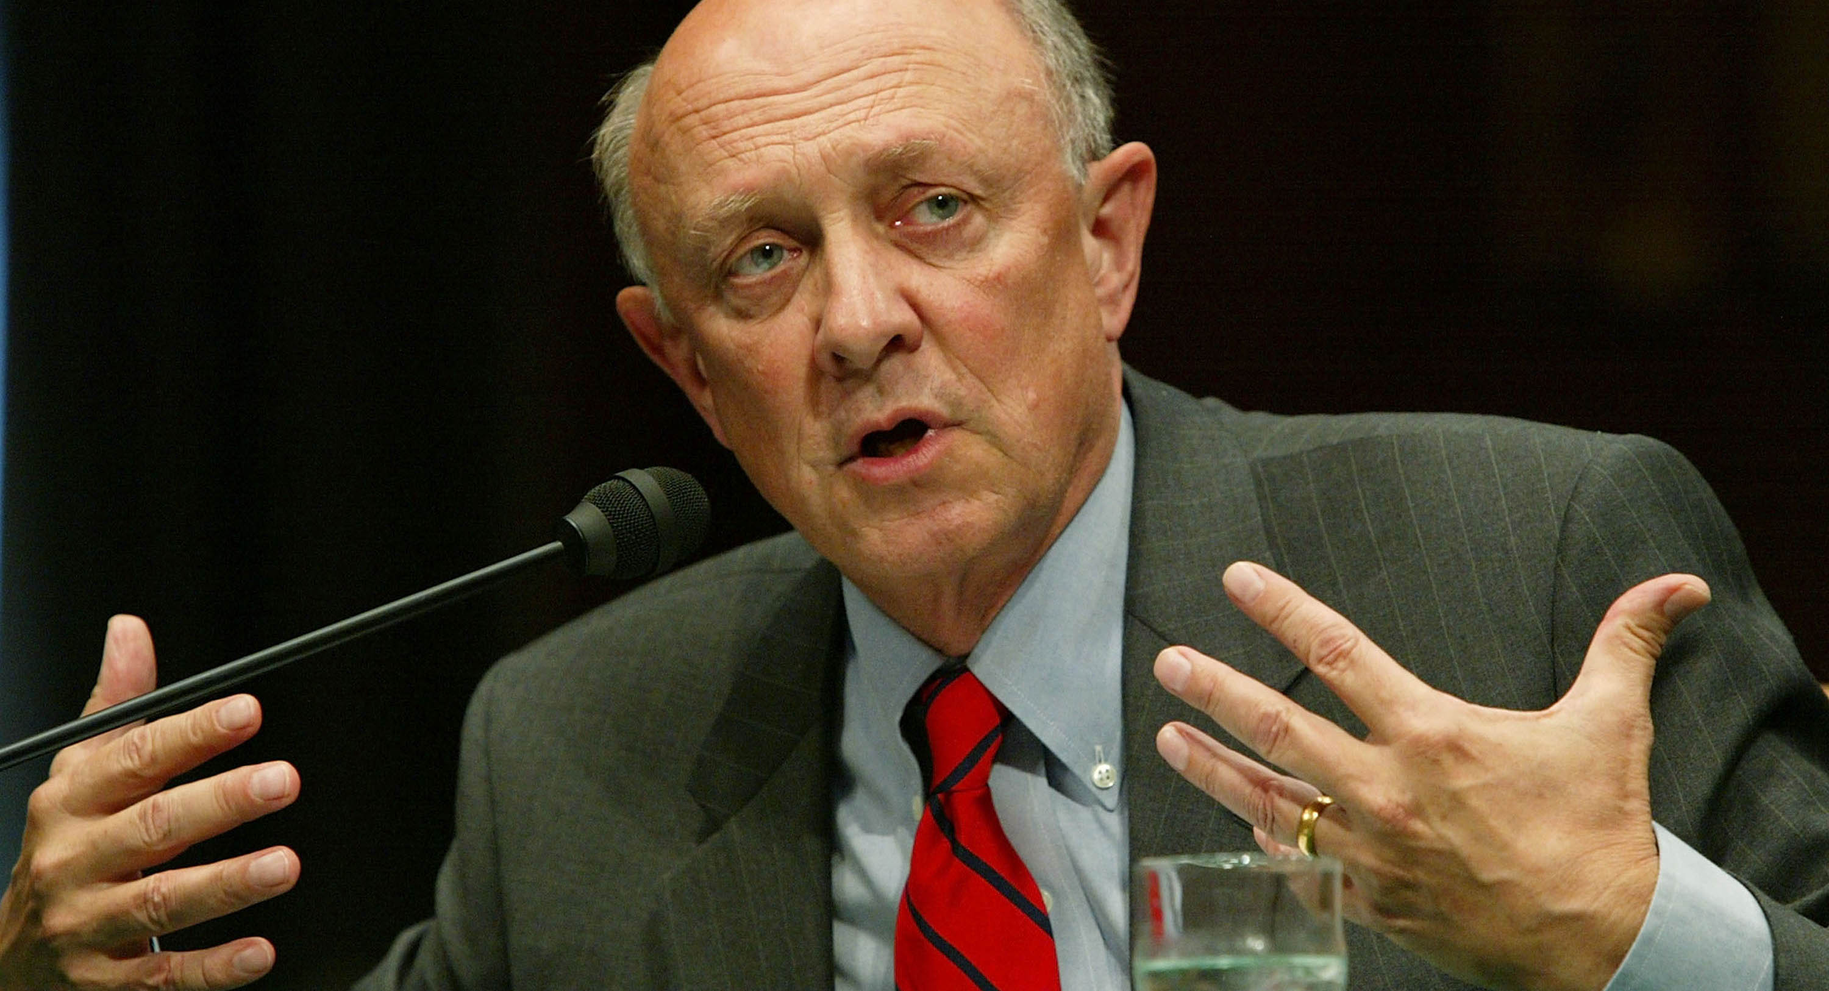
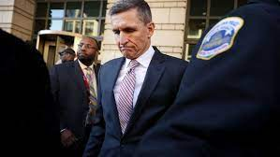
Policy Changes
Trump Administration
  Reconciliation Attempt
    National Security Advisor Michael Flynn
    Central Intelligence Agency Director James Woolsey
  CAATSA (Countering American Adversaries Through Sanctions Act) 2020
    Russian S-400 & U.S. F-35
[1]
[2]
CIA Director James Woolsey (Left)
NSA Michael Flynn (Right)

Slide 8
The case for the “failure”
Turkey’s history of coup attempts
Strong military-military ties
Lt. General Michael Flynn *advanced knowledge
Russian advance knowledge
Failed to imagine the impact of Gulen
Deterioration of relations with a key strategic ally
[5]
[3]
[5]

Slide 9
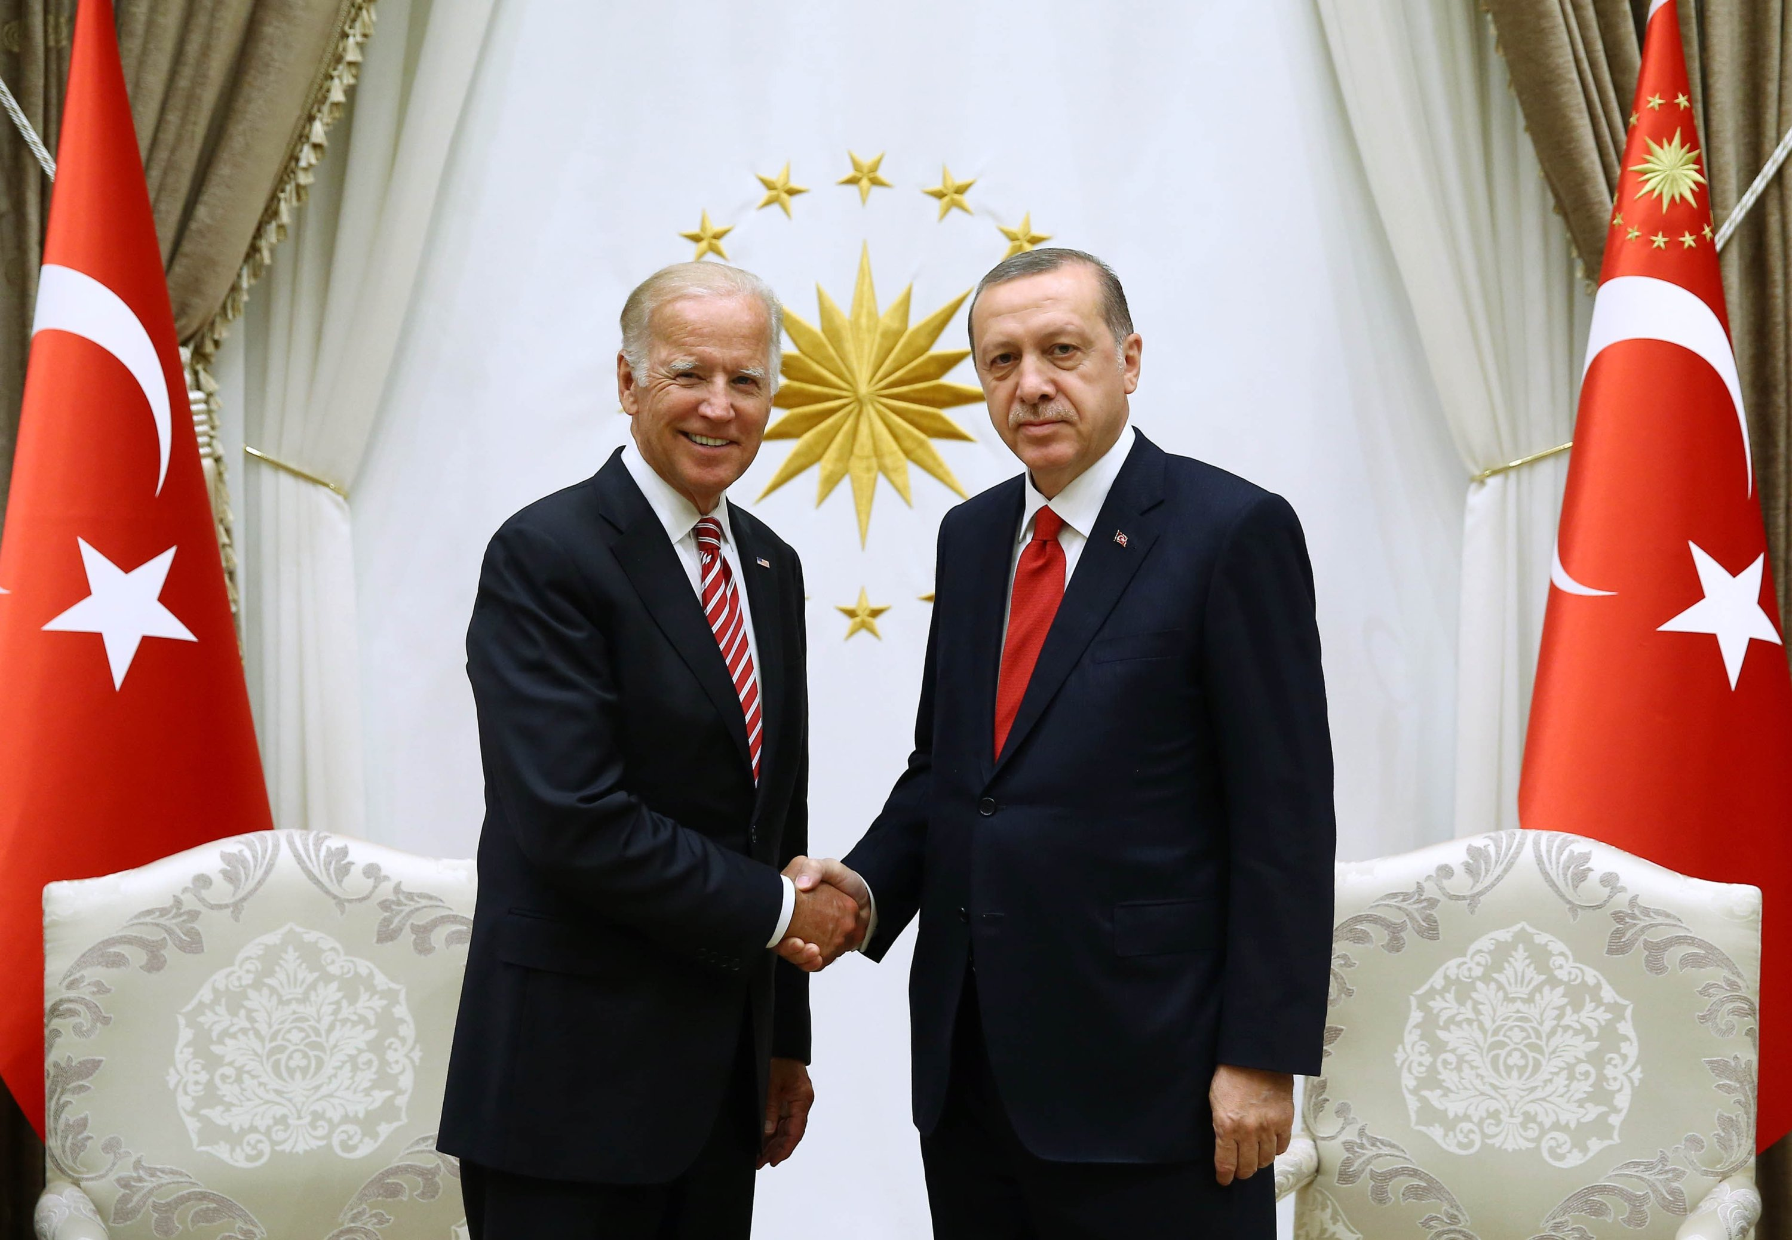
Can policy changes save the relationship?
Too far gone
  Defeat of ISIS
  Turkish military independence
  Erdoğan’s purges
Fixing Biases
  Improving HUMINT
  Diversity of opinion
  Planning for the next event

Slide 10
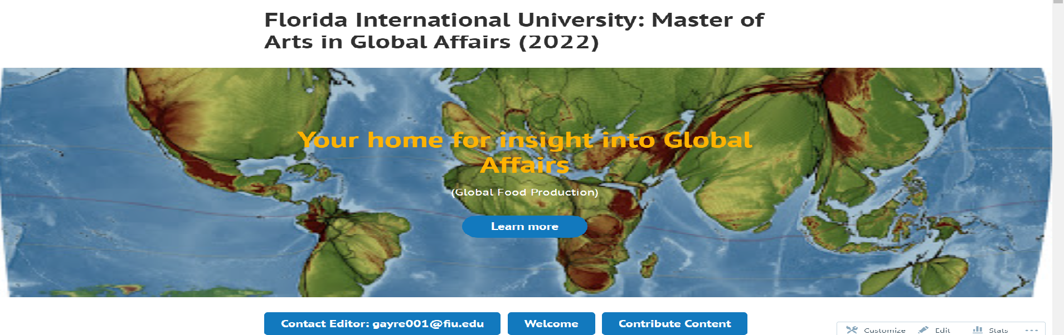
Thank you for your time! For more on Global Affairs!

Slide 11
Citations
[1](www.dw.com), D. W. (n.d.). Questions abound, one year after Turkey's coup that wasn't. DW.COM. Retrieved February 26, 2022, from https://www.dw.com/en/questions-abound-one-year-after-turkeys-coup-that-wasnt/a-39701955
[2]Eissenstat, H., Tol, G., Barak, T., & Authors, V. (2022, February 25). Unpacking Turkey's failed coup: Causes and consequences. Middle East Institute. Retrieved February 26, 2022, from https://www.mei.edu/publications/unpacking-turkeys-failed-coup-causes-and-consequences
[3]KevinWilliamB. (2019, January 18). Two associates of ex-trump national security advisor Michael Flynn indicted on conspiracy charges related to Turkish cleric Fethullah Gulen. CNBC. Retrieved February 26, 2022, from https://www.cnbc.com/2018/12/17/ex-associates-of-former-trump-aide-michael-flynn-indicted-in-turkey-case.html
[4]Kingsley, P. (2017, July 13). Mysteries, and a crackdown, persist a year after a failed coup in Turkey. The New York Times. Retrieved February 26, 2022, from https://www.nytimes.com/2017/07/13/world/europe/turkey-erdogan-failed-coup-mystery.html
[5]World Bank . (2022). Foreign direct investment, net inflows (BOP, current US$) - Turkey. World Bank Country Indicators: Turkey. Retrieved February 26, 2022, from https://data.worldbank.org/indicator/BX.KLT.DINV.CD.WD?end=2020&locations=TR&start=2010
[6] Press, A. (2016, July 17). Turkey quashes coup; Erdogan vows 'heavy price' for plotters. CGTN America. Retrieved March 1, 2022, from https://america.cgtn.com/2016/07/16/turkey-quashes-coup-erdogan-vows-heavy-price-for-plotters

