Slide 1

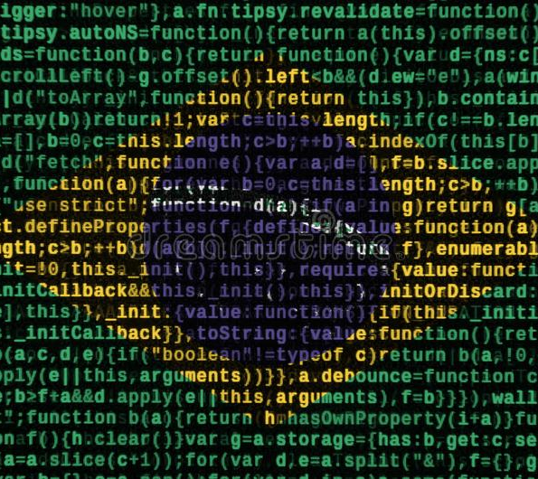
Evolution and Pursuit of Cyber Security in Brazil
Gregory Ayres & Gabriela Jarquin
Full Report: www.globalaffairswithgregayres.com/go
Notes:
Hello All and welcome back to the Channel: Global Affairs with Greg Ayres
Today we are discussing the Evolution and Pursuit of Cyber Security in Brazil
A joint project developed by myself, your venerable host and Mrs. Gabriella Jarquin of Florida International University.
I will be discussing our recent joint paper on Cyber Security in Brazil. In it we detail Brazil's cyber history, the evolution of Brazil’s cyber legislation, and put forth 7 recommendations to augment Brazil's current 2020 E-Ciber Strategy.

Slide 2
Overview
Evolution of Brazilian Cyber Security
Current Trends: Cyber Crime in Brazil
Policy Recommendations
  1) Establish a Centralized Governance Model
  2) Enhance Legal Framework
  3) Increase Infrastructure Funding and Accountability
  4) Encourage the Development of Innovative Solutions
  5) Increase Societal Collaboration
  6) Improve Maturity through Sponsored Cyber Exercises
  7) Increase Partnerships
Role of the Public and Private Industry
Conclusion
“Brazil’s outsized exposure to cyber threats is a product of haphazard policy changes, flawed organizational structuring, and political instability.”
Notes:
We will be discussing the flaws within Brazil’s cyber security strategy, identify the root causes, and make seven distinct policy recommendations to improve Brazil’s cyber security.
We begin with a short quote from our paper:
Brazil’s outsized exposure to cyber threats is a product of haphazard policy changes, flawed organizational structure, and political instability.
Moving forward in the presentation we will provide a short background on Brazil’s cyber history………. And then cover Brazil’s current trends in cyber crime.
We put forth 7 policy recommendations derived from global and regional best practices which address Brazil’s cyber security obstacles and headwinds.
Finally we will discuss the role that private enterprise can play in assisting the Brazilian government with these strategic revisions and their implementation.
We will begin with a visualization of Brazil’s cyber history…………………………….

Slide 3
Evolution of Brazilian Cyber Security
Internet Adoption Rate & Economic Growth
  Increased Connectivity Contributes to Increased Risk Exposure
Strategic Delay: 2005 NDP [1]
Strategic Home: 2016 COMDCiber [2]
Strategic Future: 2020 E-Ciber
[2]
[1]
Notes:
So we start with a brief overview of the evolution of Brazilian Cybersecurity.
As it can be seen in the figure depicted, Brazil’s adoption of the internet in the early 1990s coincides with a massive increase in Brazil’s GDP; Internet adoption continues to rise and proves a strong driver of Brazil’s economic growth, even now as Brazil’s economy cools.
As a primary driver of the Brazilian economy, this cyber space needs to be secured, as increased connectivity leads to increased exposure and risk.
For decades Brazil has operated behind the technological curve.
There was strategic delay, When Brazil’s National Defense Policy first mentions cyber space in 2005, over 20% of the nation was already online.
We can see point 1 here is a bit late to the party.
It took another 11 years for cyber strategy to find a home, by the time COMDciber
(commando cibernetico…. Which is hosted within the Brazilian army)
is created in 2016 over 60% of the nation has internet access and the nation has suffered multiple cyber attacks.
This 11 year gap, from points 1 to 2 represents a lost decade, as cyber security strategy and policy was endlessly parsed between agencies.
Presently the 2020 E-Ciber strategy governs, when it was published in 2020 it was intended to govern for 3 years, but a great deal has changed throughout the world and cyber threats are too dynamic to delay.
We will take a look at the current trends in Cyber Crime in our next slide.
You may notice, that our chart, with data provided by the U.N World Bank, is current as of 2019, unfortunately, current data is unavailable, and in a way reflective of Brazil’s cyber security deficit.

Slide 4
Current Trends: Cyber Crime in Brazil
Most Targeted Nation in LATAM
  $100 Billion Annually by 2023 (7% of GDP)
733 Million Attacks in 2021
  Trending Up & Under Reporting
Targeting Government Services
  Ministry of Justice, Ministry of Health, Powerplants, ANATEL Telecommunications
Targeting Private Industry
  Banking Sector: (Tetrade) (Bizarro) (ATM Hacking)
  Phishing & Fraud: (Business Exec. Spear Phishing)
Notes:
By all available metrics, cyber crime is on the rise in Brazil.
Brazil is by far the most targeted nation in Latin America, and by some metrics the 3rd most targeted globally (behind only China and the United States).
Brazil faced 733 million cyber attacks in 2021…………………..that’s more than 3 per person annually… And the number is likely higher, as cyber attacks often go unreported or even unnoticed.
If you look at the figure on the top right, you can see an overwhelming majority of these attacks originate within Brazil………………
………………………… The tall bar on the top right chart…………………….That’s 82.3%............... Brazil is in way its own worst enemy.
Brazil is plagued by a variety of attacks, Scams, Fraud, Denial of Service, and Worms, amongst others. With trends demonstrated in the bottom right graphic. We can see scams (that’s the red line) remain the most popular……………… and worringly……………… worms (that’s the orange line)………… are on the rise.
All of this crime, comes at a cost
Hard numbers, We are talking $100 Billion, that’s 7% of Brazil’s GDP.
This cost is likely undervalued. As it can fail to capture the investments canceled, business not opened, or damage from loss of faith or prestige.
Government Services and Private industry are the two largest “fish” or targets in Brazil.
Since 2021, Brazil’s ministry of justice was incapacitated by cyber attack for almost 2 months by ransomware groups. The ministry of health saw vast sums of public health and vaccine data leaked to the public. Nuclear powerplants and telecommunications plants have fallen under attack.
The Attacks on nuclear power infrastructure …………………truly highlight Brazils risk exposure in a frightening way.
Within the private sector the banking sector is the most common target.
Everything from ATM hacking, spear phishing, to advanced banking trojans, mostly generated within Brazil, are deployed are wreck havoc.
Perhaps the most worrying trend is the growing sophistication of domestic origin cyber attacks, notably those “worms” I previously mentioned
Brazil is the birthplace of the Tetrade banking trojan, part of the Bizarro family.
Brazil is also home to operatives of the Lapsus Group, notable for their ransomware attacks in Brazil and Europe. Brazil has also fallen victim to foreign groups from North Korea and China.
But again, these constitute some of the larger scale attacks, while most attacks are locally originated and smaller in scale.

Slide 5

7 Policy Recommendations
Establish a Centralized Governance Model
Enhance Legal Framework
Increase Infrastructure Funding & Accountability
Increase Societal Collaboration
Increase Partnerships
Encourage the Development of Innovative Solutions
Improve Maturity Through Sponsored Cyber Exercises
Brazilian Presidential Front-Runners
(L) Jair Bolsonaro & (R) Lula Da Silva
Notes:
We are putting forward 7 Policy Recommendations for the Brazilian government.
Each recommendation will be scored from high to low on cost, pace of change, and impact.
Establish a centralized governance model
Enhance the existing legal framework (particularly the capacity for attribution and prosecutions)
Increase infrastructure funding & accountability)
Increase societal collaboration (bringing in non-governmental entities)
Increasing partnerships
Encouraging the development of innovative solutions
Improving maturity through sponsored cyber exercises
These policy recommendations would flow through the Brazilian federal government. Currently led by President Jair Bolsonaro……….. While former President Lula Da Silva is currently polling as his most likely successor.

Slide 6
1) Establish a Centralized Governance Model
Low Cost + Medium Pace of Change + High Impact
“Comando Cibernétio”
  Apolitical body (BACEN)
  Coordinating capability below President
Consolidation of jurisdiction and responsibility
Current Organizational Structure
Proposed Organizational Structure
President
MD
GSI
Army
Navy
Air Force
COMDCiber
CDCiber
CTR.br
Police
ABIN
MJ
President
Comando Cibernético
MD
GSI
Army
Navy
Air Force
ABIN
MJ
Police
CTR.br
Notes:
Recommendation #1)
Establishing a centralized governance model.
This represents a low cost, medium pace of change, high impact solution for Brazil.
In the present system, (seen in the bottom left) the lowest coordinating authority for cyber security is the President. Leaving aside your opinions of President Bolsonaro…… this is a flawed structure. The President and Executive office should not be the sole common node for the governments cyber security actors.
All of the agencies listed below in the diagrams below
Ministry of Defense, The services, Ciber Command, The presidential Security Office, the Police, Intelligence Service and Ministry of Justice each play a role in ensuring Brazil’s cyber security.
Cyber Resilience, a core goal of the 2020 E-ciber strategy, relies upon: Defense, Attribution, Resumption of Services, and Retaliation
Our recommendation, the establishment of a centralized governance model coordinates (these) under a singular authority.
To this end, we propose the organizational structure seen in the bottom right.
Notably, the modification of COMDCiber into a genuine coordinating Command. This creates parity between Brazil’s armed services and allows for a singular body to coordinate the military, intelligence, law enforcement, and technological actors in Brazil’s government without bogging down the President.
It also promotes political independence, a bulwark against Brazil’s turbulent internal politics.
Restructuring Brazil’s Cyber actors
This represents a low cost, high impact change which can be achieved over the medium term.
The new Comando Cibernetico will coordinate all cyber security affairs below the president, offering genuine direction from approved strategy.
Comando Cibernetico, is modeled after the United States Cyber Command, and offers similar benefits as an apolitical body. As you can see in the graphic on the bottom right of the screen, Brazil’s internal politics are incalculably chaotic.
Brazil’s national bank, BACEN demonstrates the feasibility and success achievable through a stable apolitical body.
Again, Comando Cibernetico would create parity amongst the services, removing the Brazilian army’s historical reign (both politically and military)
This also allows for Brazils cyber security strategy to be de-militarized, as now strategy receives equal input from law enforcement, intel, and the military.

Slide 7
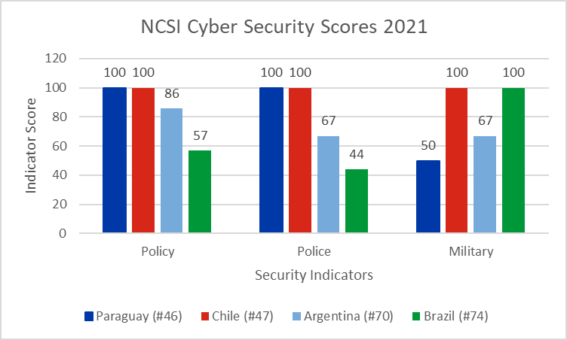
2) Enhance Legal Framework
Low Cost + Fast Pace of Change + High Impact
Pursue Policing Centric Model
  Global Best Practices (Chile, Paraguay, Baltics)
Structural Reorganization
Prosecutions as Deterrence
  Cyber Crime & Fraud: Less than 1% of Prosecutions in Brazil
  More than 3 Attacks per Person Annually
Notes:
Recommendation #2 Enhance the Legal Framework
Enhancing Brazil’s Legal Infrastructure and adapting to global best practices, in line with top performing Latin American Nations ( such as…..Chile and Paraguay) represents a low cost, …….high impact ………course of action which can yield rapid results.
Global and regional leaders utilize policing centric models, ………which primarily view cyber security through a law enforcement lens. This shift will require moving COMDciber out of its purely military role to the proposed position from the previous slide where it plays a coordinating role.
Latin Americas top ranking nations (Chile and Paraguay) place control of cyber security under national police and telecommunications agencies respectively. This approach is mirrored in the worlds highest performing cyber nations, which avoid outright military preeminence in cyber security affairs.
In order to serve as an effective deterrent, Brazil has to achieve an increase in cyber crime prosecutions. Less than 1% of all arrests in Brazil are for fraud or cyber crime. Genuine deterrence will require increased attribution capabilities. A gap which is occasionally filled by foreign nations, mostly the US and EU, in high profile cases. But Brazil evidently needs help attributing attacks, and this help can come from foreign nations or consultation with private firms. Again, with 733 million attacks a year, that’s more than 3 attacks per personal annually.
In the figure on the bottom right we see the NCSI scores for Paraguay (Dark Blue), Chile (Red), Argentina (light blue) and Brazil (green). We can see that Paraguay and Chile dominate in policy and policing rankings. They also have the highest overall scores in Latin America. In contrast, Brazils perfect score in “military” fails to translate, as they score worst amongst the sampled nations. The same story is true throughout Latin America, as nations with a prioritization on military power in cyber security underperform peers.

Slide 8

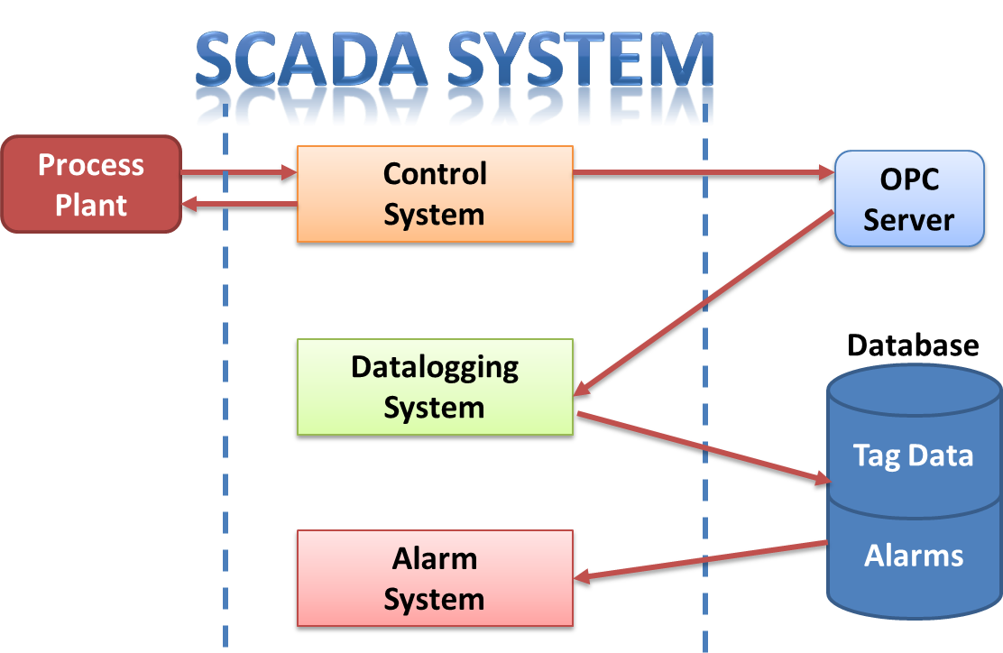
3) Increase Infrastructure Funding & Accountability
Ministry of Justice and Public Security
High Cost + Slow Pace of Change + High Impact
19,500 attacks on Infrastructure in 2019
  Power-Plants
    Eletrobas + Companhia Paranaense de Energia
  Government Websites
    Ministry of Justice + Ministry of Health
Update and Replace Hardware
Segment and Update Software
SCADA Control Systems
Notes:
Recommendation #3) Infrastructure and Accountability
This represents a high cost, high impact recommendation which can be achieved over the long term.
Upgrading and updating hardware is expensive and time consuming. This factors heavily into recommendation #3’s scoring.
Brazil’s infrastructure suffered 19,500 attacks in 2019. By far the most in Latin America.
Notably, powerplants from Eletrobas and Companhia Paranaense de Energia were hit.
The Ministry of Justice…… and Ministry of Health websites were attacked ……. as data storage was compromised and ransomed.
Updating and replacing hardware, like out of date and susceptible SCADA (Supervisory Control and Data Acquisition) controllers is a historical challenge. Outdated and unpatched SCADA controllers were at fault for a swathe of attacks on power providers in 2018, a fault that remains largely unaddressed.
Segmenting infrastructure networks is another key priority. As threats and incursions must be isolated to minimize damage.
The Brazilian government can fund these initiatives, and use penalties to enforce accountability, but private industry must supply the hardware/software, and businesses such as Accenture may be best suited to maintain and update or patch existing devices or code.

Slide 9

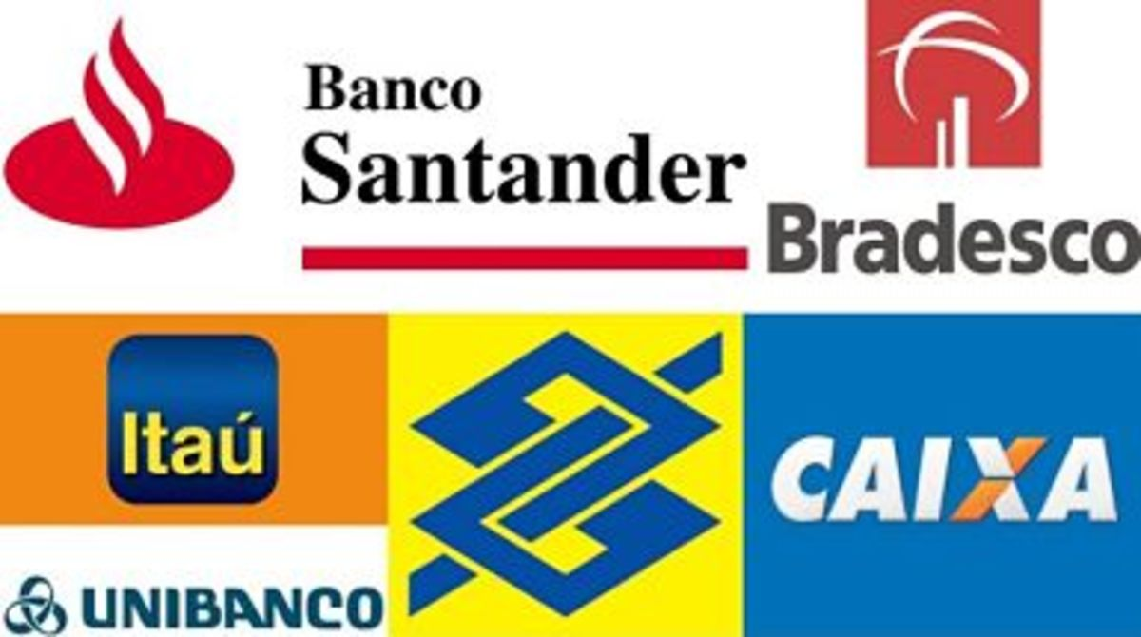
4) Increase Societal Collaboration
Low Cost + Low Impact + Moderate Pace of Change
Instituto Brasiliero de Defensa do Consumidor (IDEC)
  Public Awareness + Education + Cyber Defense at the Societal Level
  200,000 cases annually
Increasing private sector participation in exercises
  Public-Private-Partnerships and Exercises Sponsors
Inclusion: Banking Sector & Finance
  Legislation, Regulation, Standardization, Education
Brazilian Institute of Consumer Protection
Brazil’s Largest Banks
Notes:
Policy Recommendation #4) Increasing Societal Collaboration
This represents a low cost, low impact set of changes, which can be achieved over the medium term.
Government engagement………. The support of non-profits and industry working groups …….fosters buy-in from stakeholders capable of self-generating security.
IDEC is a model non-profit in Brazil. They perform a role similar to the “consumer protection agency” in the united states …..They publish reports and inform the public of notable Scams and Cyber risks. There logo is here on the top.
They are popular amongst the public, increase public awareness, educate consumers, and increase whole of society defense…….. But they only publish and report on 200,000 cases annually……. And remember there were 733 million reported attacks in 2021…….. So there is a capacity gap, which the government might help fill.
Brazil can increase private sector collaboration by sponsoring more cyber security exercises, and ……….working with private sector companies to develop of host competitive events.
Including the banking sector (With Brazil’s largest banks featured in the bottom right graphic) in a meaningful way to create proactive regulations can benefit all banking users ( Code for Brazilian Society). Many of Brazils banks led the charge on 2 factor authentication at ATM’s but industry should work hand-in-hand with government in matters of security and its time for the Government of Brazil to catch up.

Slide 10
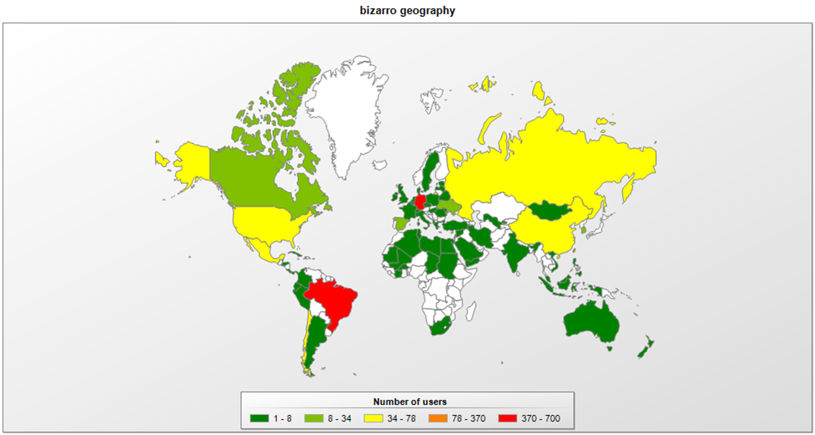
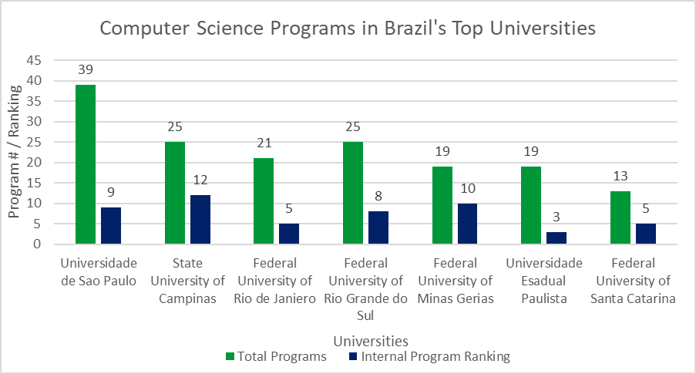
5) Increase Partnerships
Impact of Brazilian Banking Trojans
Medium Cost + Medium Pace+ Medium Impact
EU + USA + LATAM
Academia
Policing & Attribution
  Attribution + Updates + SMEEs
  Cyber Guardian
Notes:
Increasing Partnerships
This is a middling cost, middling impact recommendation that can yield results over the medium term.
Brazil has global partnerships…….. but they could be stronger.
Primary partners include the EU……. (notably Portugal and Spain for linguistic and cultural reasons), ……….the United States, and some of Brazil’s continental peers.
The most beneficial relationships stem from the U.S. and E.U. ……….particularly in the form of SMEE’s (Subject Matter Expert Exchanges), advanced technological applications, acquisitions, and attribution.
Brazil benefits greatly from this attribution work performed by the US and various EU governments, notably in tracking banking trojans.
(The map in the top right reflects a multinational effort, which tracked the spread of the Bizarro banking trojan). Truly global problem.
Increasing collaboration with Academia is likely required, as Computer Science programs under perform other departments at each of Brazil's 7 largest universities. The universities are displayed here on the bottom right. With the green bar reflecting the total # of programs offered and the blue bar showing the internal ranking of the universities Computer Science department. Note, none of these computer science programs cracked the top half of programs offered.
This opens the door for increased benefit from international academic exchanges.
This leads us into attribution and policing. Given the truly global nature of cyber crime, international partnerships and relationships are required to track, detain, and prosecute cyber criminals.
Brazil can benefit greatly from increased participation in exercises like Cyber Guardian, which to date is an Army dominant exercises.
We will touch more on Cyber Exercises in the next 2 recommendations

Slide 11
6) Encourage the Development of Innovative Solutions
Medium Cost + Slow Impact of Change + High Impact
Innovation is Elusive
Proactive Solutions, Creative Victory
  Capture The Flag (CTF) Exercises
Private Management of Cloud Storage
  Dataprev & Serpro
Notes:
Innovation, its harder than it sounds, ……….and it sounds hard.
Investing in innovation represents a medium cost, high impact recommendation which yields result over a long time frame.
Innovation might pay off…………… but you never quite know when in real time.
Encouraging innovation from a cyber security perspective………… really means being proactive.
The dominant format for proactive solutions is performing exercises or competitions.
Brazil can federally sponsor more competitions, ……………..such as the global Capture the Flag competition.
Brazil has performed increasingly well over recent years, but does not enter as many teams as global leaders in cyber.
Private enterprise can similarly sponsor competitions, ……….and this can be an excellent branding and recruiting tool.
Promoting participation and rewarding success in cyber competitions and exercises is a relatively cost effective way to stimulate innovation.
The Brazilian legislature is ready to move forward, funding contracts for private enterprise to take over data storage/management services from the government. But Pres. Bolsonaro…………..has delayed………… and delayed…. Brazilian companies Dataprev and Serpro are waiting…..
For 3 years. Brazil’s complicated history of privatization is at play. But a positive result here could open the door for further privatization and innovation…. As current government systems are not securing public data.
Innovation is risky and can be costly, but it’s a necessity to confront the dynamic challenges.

Slide 12
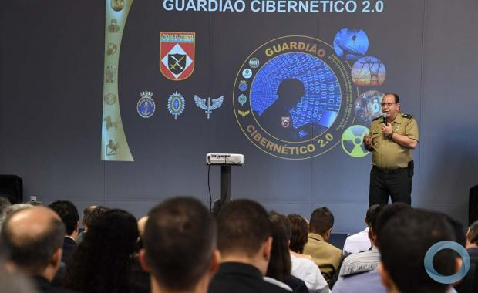
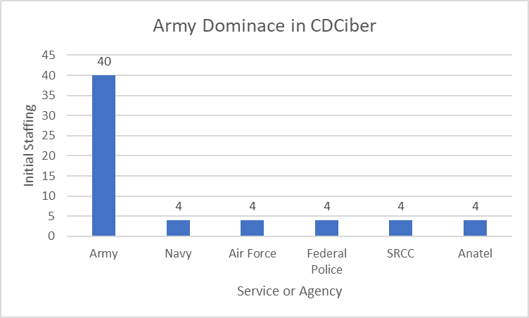
7) Improve Maturity Through Cyber Exercises
Ltg. Guido Amin Naves (Army)
Low Cost + High Impact + Fast Pace of Change
Cyber Guardian 4.0
  Maturity & Resilience: Get Proactive
  Broader Incorporation: Military, Academia, Private Sector, International Partners
Notes:
Cyber Exercises
These represent a low cost, high impact recommendation that can produce immediate results.
Cyber Guardian is Brazils largest Cyber Security exercise, (by some estimations the largest in Latin America) And as hinted earlier dominated by military ….. (Particularly)………. Army participants, as you can see here in the bottom right, that’s 40 from the Army and 4 from everywhere else.
Exercises are the pinnacle of cyber maturity, they represent a proactive approach and can readily include stakeholders from across society.
We can see here a photo from Brazils 2nd ever Cyber Guardian exercise. And who do we have presiding….. Army Lt General Naves.
But they need broader participation to be optimal. As we have stated, cyber security policies centered about the military……… ignore global best practices.
They need participation from across Brazilian society, and this is where private companies can play a role.
The independent development of exercises generates genuine surprise and forces the government to adapt to genuinely foreign challenges.
Participation from academia, and foreign allies is also recommended as many cyber fights fail to acknowledge or respect national boundaries.

Slide 13
Governance Actions & Private Industry
7 Policy Recommendations
Private Sector Contributions
Establish a Centralized Governance Model
Enhance Legal Framework
Increase Infrastructure Funding & Accountability
Increase Societal Collaboration
Increase Partnerships
Encourage the Development of Innovative Solutions
Improve Maturity Through Sponsored Cyber Exercises
Hardware & Software
Technological Expertise
Threat Detection & Attribution
Cost Savings
Innovate Technology & Solutions
Global Best Practices
Notes:
So………. Our 7 policy recommendations……….
Establish a centralized governance Model
Enhance the Legal Framework
Increase Infrastructure Funding & Accountability
Increase Societal Collaboration
Increase Partnerships
Encourage the Development of Innovative Solutions
Improve Maturity Through Sponosred Cyber Exercises
So where does the private sector fit in?
They will have to provide the hardware/software……… atleast until Brazils domestic industries mature
Technological expertise
Threat detection and Attriution…………….. Again, they face truly global threats
Cost savings potential
Innovate Technology and Solutions
Importing Global Best Practices
So now to take a deeper look at private industry

Slide 14



Private Industry
Role of Private Industry:
  Coordinating Software Patches & Updates
  Network Segmentation
  Protecting Relays & Ports
  Multi-Factor Authentication & Zero Trust Standard
Private Participation in Exercises (Cyber Guardian)
Infrastructure Maintenance & Software Updates
Supporting Non-Profits (IDEC)
Private Cloud Storage/Management of Public Data
Notes:
So with this government approach, how do private companies fit in……….
They can fill a number of roles given their technological expertise……….. And Brazils demonstrated limitations……….
Coordinating software patches & Updates (those SCADA controllers had vulnerabilities that were public knowledge 8 years prior.
Network Segmentation (A few phishing emails incapacitated the entire Ministry of Justice)
Protecting Relays & Ports (History of telecommunications failures)
Multi-Factor Authentication & Zero Trust Standards (Need to improve banking security, mostly through login vulnerabilities)
They can participate in exercises, even take the lead with tailored of off the shelf products
They can oversee infrastructure maitenence and software updates, where their global reach and technological expertise provides an advantage.
They can support non profits like IDEC, enhancing the messaging and educational efforts of an already successful and popular program.
They can provide new capabilities, like private cloud storage / management of public data. A case study we covered in detail in our paper. One that addresses a current expressed need, that Brazil has attempted and stalled addressing for over 3 years.

Slide 15
Conclusion
Each of the 7 Recommendations Support Brazil’s 2020 E-Ciber strategy
The Brazilian Government Will Play a Pivotal Role in Brazil’s Future Success or Failure
Potential Societal Impact
  Catalyzes Economic Growth
  Free and Transparent Political Dialogue
  Safe and Reliable Utility Services
  Personal Data Security
  Reduction in Crime and Economic Losses
  Increased Soft-Power and Regional Influence
  Increased Faith in Governance
Notes:
These 7 recommendations each support and enhance Brazil's current 2020 E-Ciber strategy.
Again, these 7 recommendations constitute “governance actions”, as outlined in the scope of our project. And fittingly so, the Brazilian government will play a pivotal role in Brazil’s future success or failure.
There is a lot on the line, Cyber Security success would have a major societal impact.
Catalyzing economic growth
Providing a free transparent place for political speech
Delivering safe and reliable utility services
Personal Data Security
Reduced Crime
Increased soft power and regional influence
Return to faith in governance.
In conclusion
Each of the 7 recommendations support Brazil’s E-Ciber strategy, they provide more clarity and reflect both realities and opportunities.
The Brazilian Government will play a pivotal role in Brazil’s future success or failure, but it is unlikely to succeed with support from relevant actors and stakeholders.
All this means Brazil will need support for there governance actions
Buy in from Brazilian Society
Collaboration with International Organizations and Partners
Expertise from the private sector

Slide 16

Thank You!
Any questions?
Full Report: www.globalaffairswithgregayres.com/go

Slide 17
Backup Slides

Slide 18
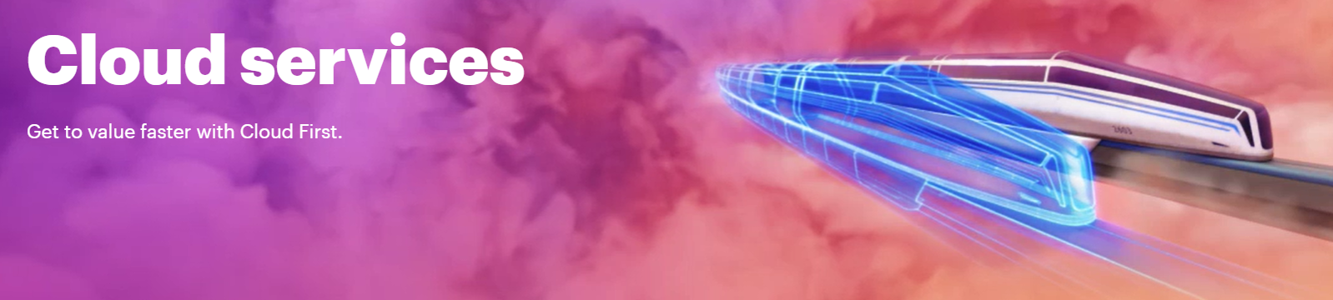
Cloud Storage / Management Solutions
Demonstrated Need for Increased Security and Accessibility of Brazilian’s Personal Data
  Data Breaches 2019, 2020, and 2021
  Popular Support but Presidential Stalling
Private Solutions (Accenture)
  Cloud Storage & Management
  Private Companies Store & Manage Access while Brazilian Government Maintains Ownership
Accenture Cloud Services

Slide 19
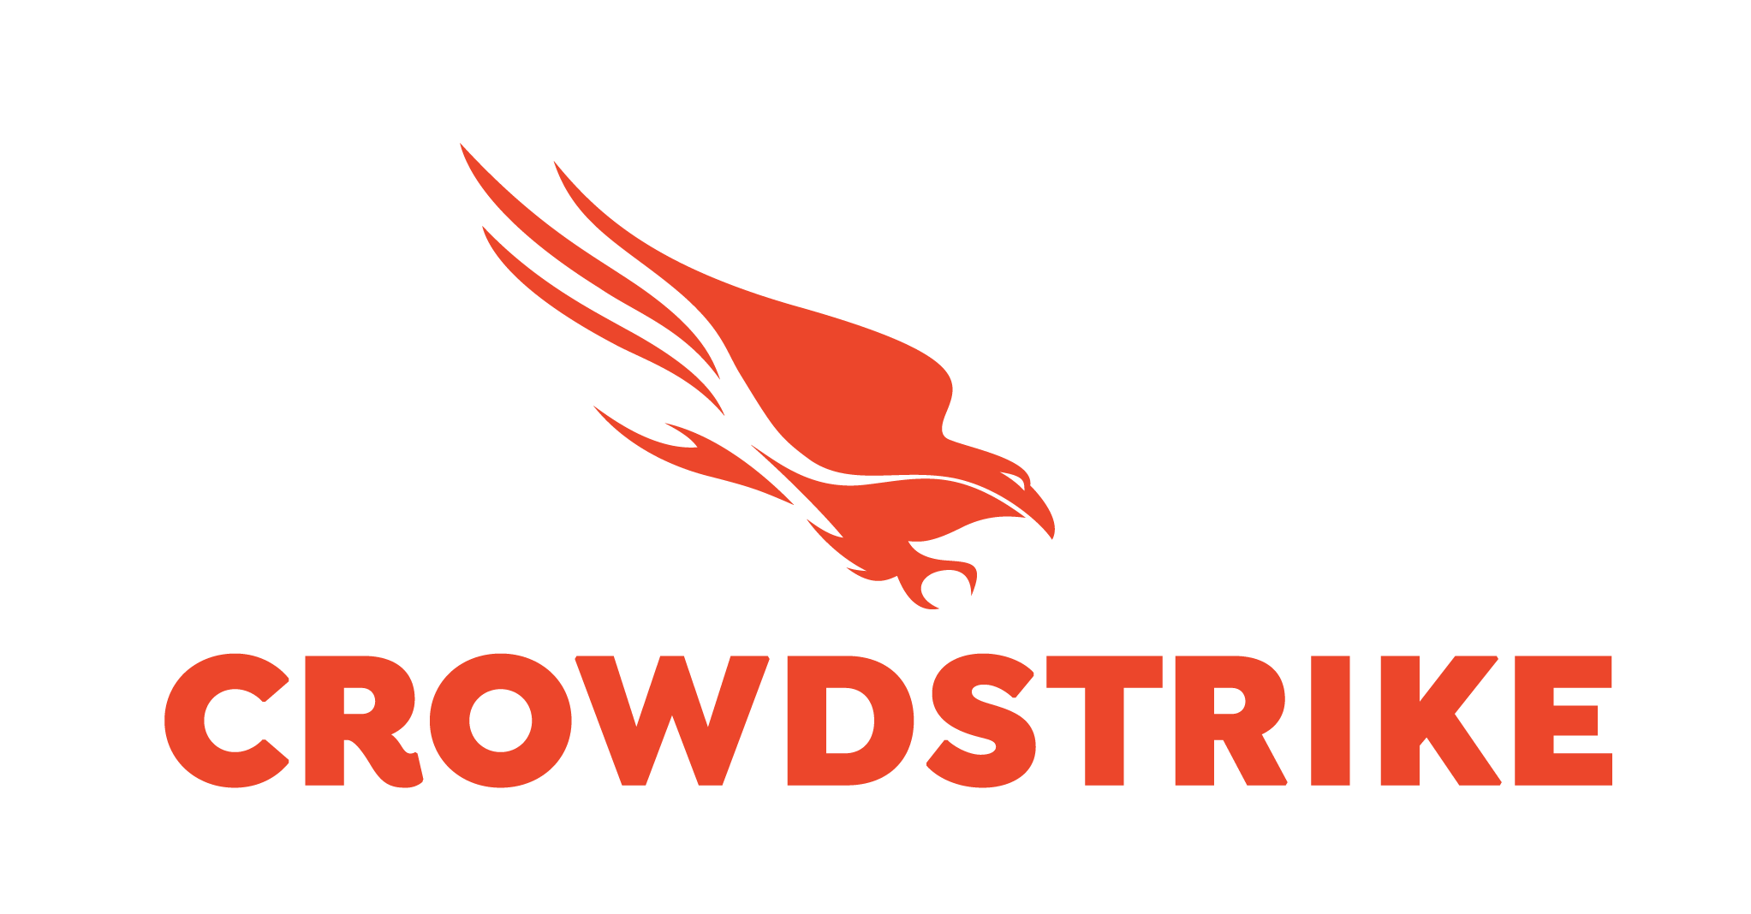
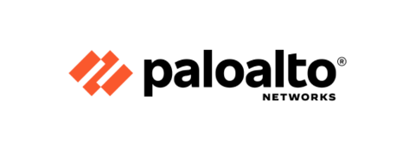
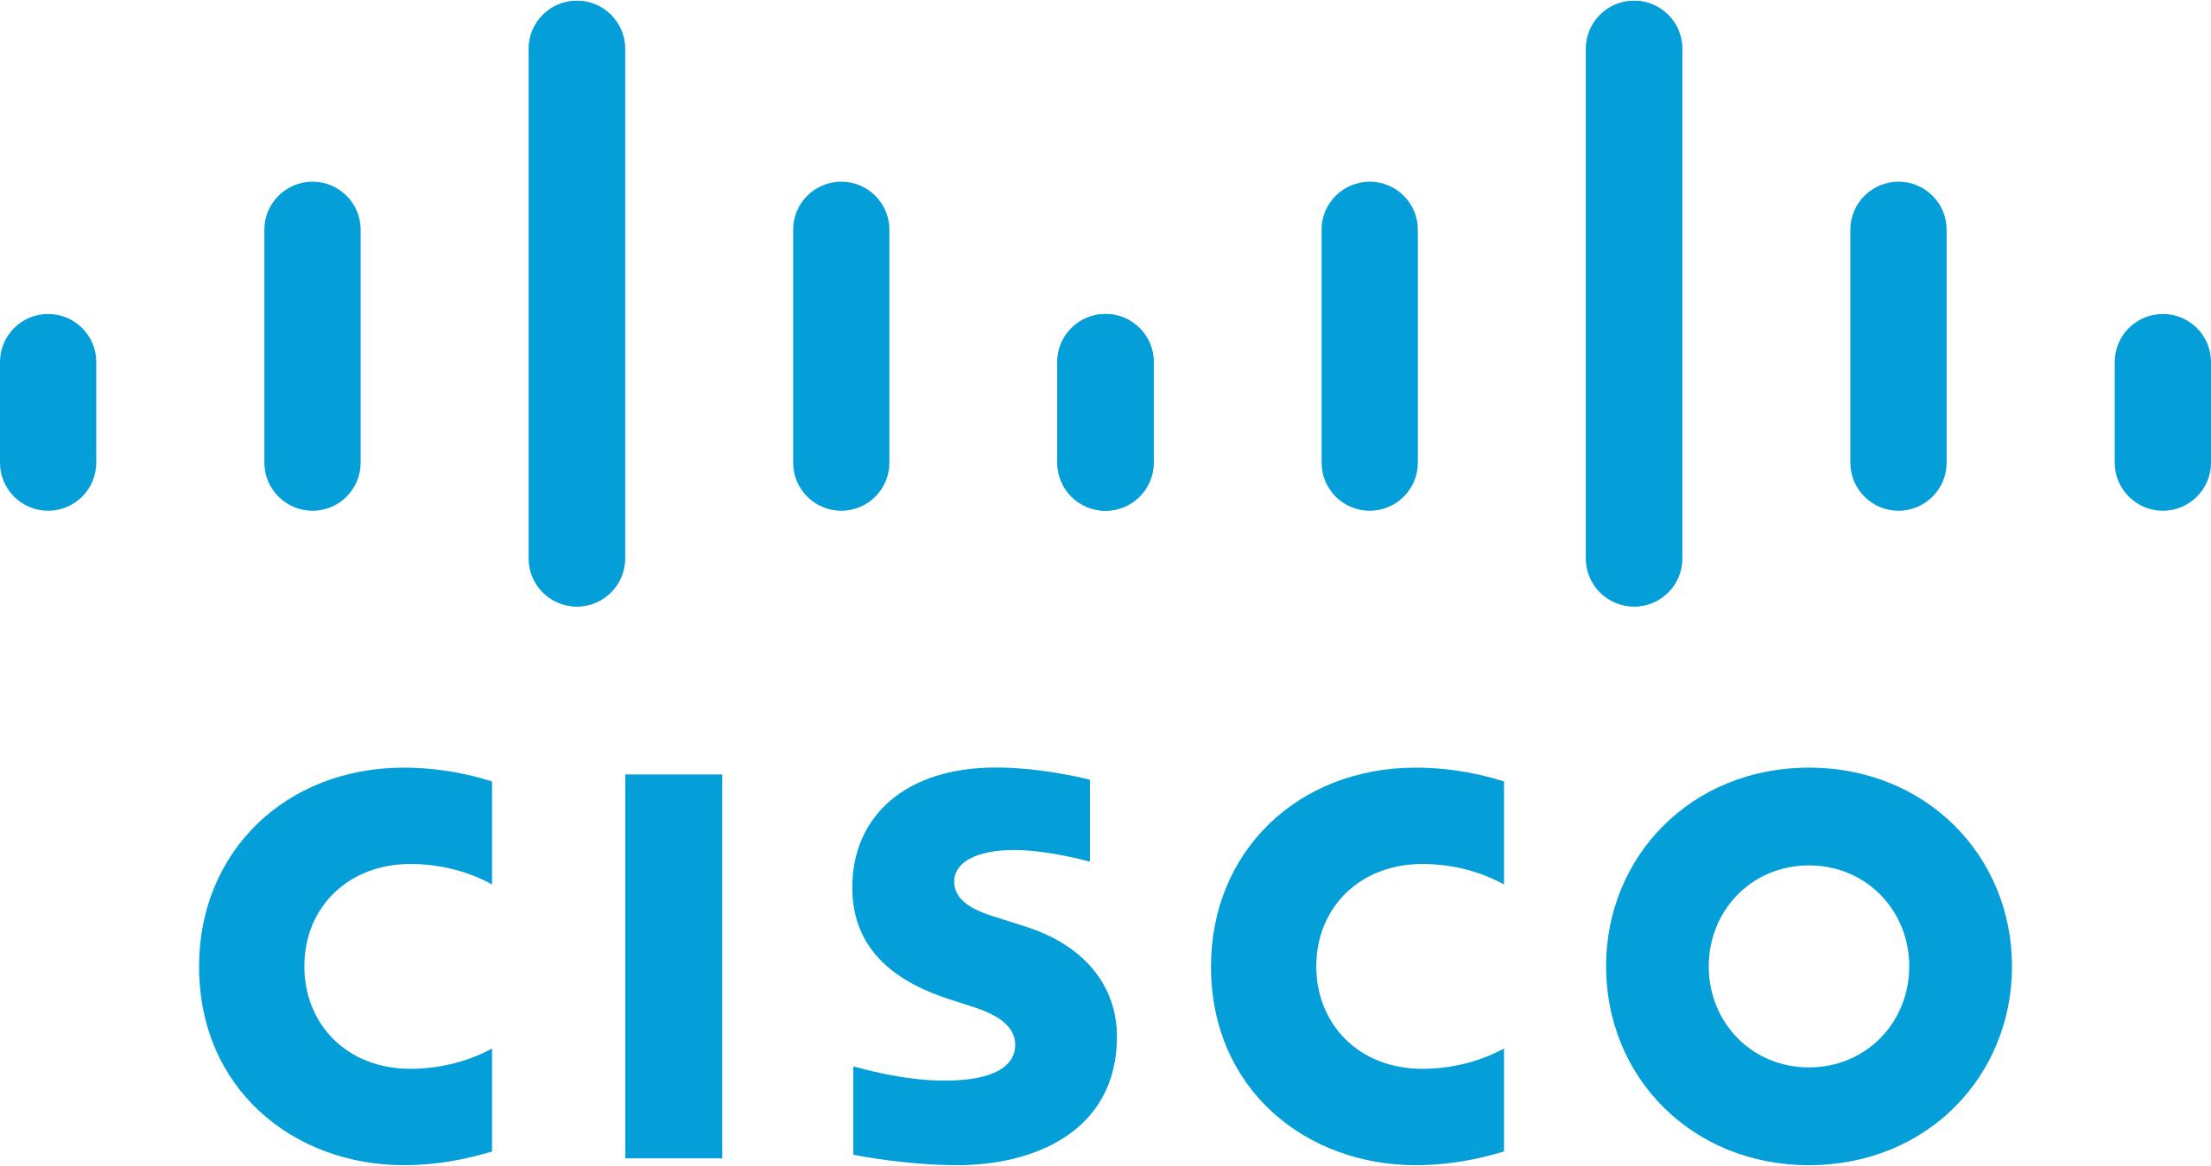
Private Exercises: Cyber Guardian 4.0
Demilitarizing Brazil’s Cyber Security
  Diversifying Participation: Academia, Domestic Industry, and Partner Nations
Private Sector Design
  Element of Surprise
  Global Expertise
  Expanded Problem Set
    Current Areas of Focus: Financial, Electrical, Nuclear, and Telecommunications

Slide 20
7 Recommendations Scoring Matrix
Recommendation | Pace | Cost | Impact
Establish a Centralized Governance Model & Empower Legislation | 2 | 3 | 3
2) Increase Societal Collaboration | 2 | 3 | 1
3) Infrastructure Funding & Accountability | 1 | 1 | 3
4) Enhance Legal Framework on Cyber Security | 3 | 3 | 3
5) Encourage the Development of Innovative Solutions | 3 | 2 | 1
6) Increase Partnerships | 2 | 2 | 2
7) Cyber Exercises & Proactive Maturity | 3 | 2 | 2

